Slide 1
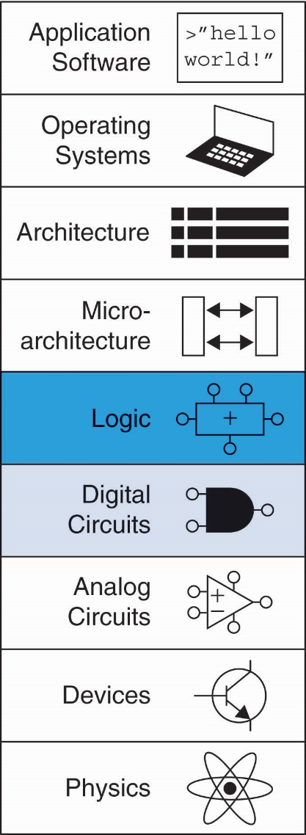
Chapter 3 :: Topics
Introduction
Latches and Flip-Flops
Synchronous Logic Design
Finite State Machines
Timing of Sequential Logic
Parallelism

Slide 2
Introduction
Outputs of sequential logic depend on current and prior input values – it has memory.
Some definitions:
State: all the information about a circuit necessary to explain its future behavior
Latches and flip-flops: state elements that store one bit of state
Synchronous sequential circuits: combinational logic followed by a bank of flip-flops

Slide 3
Sequential Circuits
Sequential logic might explicitly remember certain previous inputs, or it might distill the prior inputs into a smaller amount of information called the state of the system
Have memory (short-term)
Use feedback from output to input to store information

Slide 4
State Elements
The state of a circuit influences its future behavior
State elements store state
Bistable circuit
SR Latch
D Latch
D Flip-flop

Slide 5
Bistable Circuit
Fundamental building block of other state elements
Two outputs: Q, Q
No inputs

Slide 6
Bistable Circuit Analysis
Consider the two possible cases:
Q = 0:
then Q = 0, Q = 1 (consistent)
Q = 1:
then Q = 1, Q = 0 (consistent)
Stores 1 bit of state in the state variable, Q (or Q)
But there are no inputs to control the state

Slide 7
SR (Set/Reset) Latch
SR Latch
Consider the four possible cases:
S = 1, R = 0
S = 0, R = 1
S = 0, R = 0
S = 1, R = 1

Slide 8
SR Latch Analysis
S = 1, R = 0:
then Q = 1 and Q = 0
S = 0, R = 1:
then Q = 0 and Q = 1
1

Slide 9
SR Latch Analysis
S = 1, R = 0:
then Q = 1 and Q = 0
Set the output
S = 0, R = 1:
then Q = 0 and Q = 1
Reset the output
1
1

Slide 10
SR Latch Analysis
S = 0, R = 0:
then Q = Q_{prev}
S = 1, R = 1:
then Q = 0, Q = 0
1

Slide 11
SR Latch Analysis
S = 0, R = 0:
then Q = Q_{prev}
Memory!
S = 1, R = 1:
then Q = 0, Q = 0
Invalid State
Q ≠ NOT Q
1

Slide 12
SR Latch Truth Table
The truth table in Figure summarizes these four cases.
The outputs, Q and Q, are normally complementary.
When neither input is asserted, Q remembers its old value, Q_{prev}
Asserting both S and R simultaneously doesn’t make much sense

Slide 13
SR Latch Symbol
SR stands for Set/Reset Latch
Stores one bit of state (Q)
Control what value is being stored with S, R inputs
Set: Make the output 1
(S = 1, R = 0, Q = 1)
Reset: Make the output 0
(S = 0, R = 1, Q = 0)
Must do something to avoid
invalid state (when S = R = 1)

Slide 14
D Latch
Two inputs: CLK, D
CLK: controls when the output changes
D (the data input): controls what the output changes to
Function
When CLK = 1,
D passes through to Q (transparent)
When CLK = 0,
Q holds its previous value (opaque)
Avoids invalid case when
Q ≠ NOT Q

Slide 15
D Latch Internal Circuit (Do it)

Slide 16
D Latch Internal Circuit (Do it)

Slide 17
D Latch Internal Circuit (Done)

Slide 18
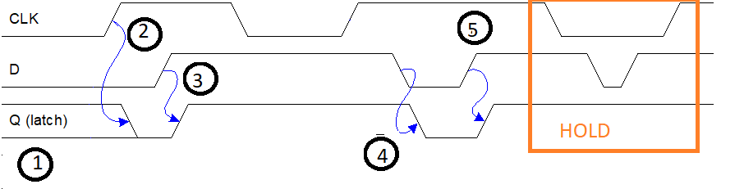
Forme d’onda del latch
1: il latch è in hold. Non sappiamo il valore di Q: è ignoto o indeterminate (ho appena acceso l’alimentazione)
Notes:
Fine lezione 4

Slide 19
Forme d’onda del latch
1: il latch è in hold. Non sappiamo il valore di Q: è ignoto o indeterminate (ho appena acceso l’alimentazione)
2: il latch diventa trasparente. Ora Q=D.
Notes:
Fine lezione 4

Slide 20
Forme d’onda del latch
1: il latch è in hold. Non sappiamo il valore di Q: è ignoto o indeterminate (ho appena acceso l’alimentazione)
2: il latch diventa trasparente. Ora Q=D.
3: il D varia da 0→1. Q segue il valore di D (CLK=1)
Notes:
Fine lezione 4

Slide 21
Forme d’onda del latch
1: il latch è in hold. Non sappiamo il valore di Q: è ignoto o indeterminate (ho appena acceso l’alimentazione)
2: il latch diventa trasparente. Ora Q=D.
3: il D varia da 0→1. Q segue il valore di D (CLK=1)
4: il D varia da 1→0. Q segue il valore di D (CLK=1)
5: il D varia da 0→1. Q segue il valore di D (CLK=1)
Notes:
Fine lezione 4

Slide 22
Forme d’onda del latch
1: il latch è in hold. Non sappiamo il valore di Q: è ignoto o indeterminate (ho appena acceso l’alimentazione)
2: il latch diventa trasparente. Ora Q=D.
3: il D varia da 0→1. Q segue il valore di D (CLK=1)
4: il D varia da 1→0. Q segue il valore di D (CLK=1)
5: il D varia da 0→1. Q segue il valore di D (CLK=1)
HOLD: D varia da 1→0. Q NON segue il valore di D (CLK=0)
HOLD: D varia da 0→1. Q NON segue il valore di D (CLK=0)
Notes:
Fine lezione 4

Slide 23
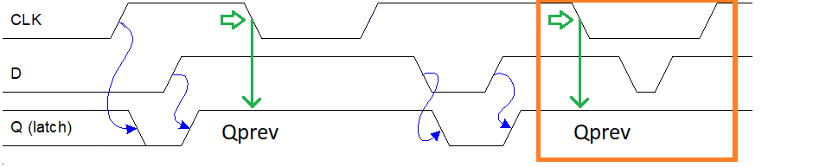
Forme d’onda del latch
L’istante in cui CLK varia da 1 a 0 è l'ultimo istante in cui il latch campiona il valore di D.
Nella finestra in cui CLK rimane a 0, l'uscita del latch rimane al valore Q_{prev} che aveva al momento in cui CLK si è abbassato
Notes:
Fine lezione 4

Slide 24
Esercizio
Disegnare un D-latch partendo da un MUX a 2 ingressi

Slide 25
Esercizio
Disegnare un D-latch partendo da un MUX a 2 ingressi
CLK
Q
D

Slide 26
Esercizio
Disegnare un latch SR partendo da un MUX a 4 ingressi

Slide 27
Esercizio
Disegnare un latch SR partendo da un MUX a 2 ingressi
S
1
R
S
Q
0
X

Slide 28
SystemVerilog: Always Statement
General Structure:
always @(sensitivity list)
statement;
Whenever the event in sensitivity list occurs, statement is executed

Slide 29
Latch
module latch(input logic clk,
input logic [3:0] d,
output logic [3:0] q);
always_latch
if (clk) q <= d;
endmodule
Warning: We don’t use latches for Verilog design in this text. But you might write code that inadvertently implies a latch. Check synthesized hardware – if it has latches in it, there’s an error.

Slide 30
Latch (old verilog style)
module latch(input logic clk,
input logic [3:0] d,
output logic [3:0] q);
always @(*) //(all inputs in sensitivity list)
if (clk) q <= d;
endmodule

Slide 31
D Flip-Flop
Inputs: CLK, D
Function
Samples D on rising edge of CLK
When CLK rises from 0 to 1, D passes through to Q
Otherwise, Q holds its previous value
Q changes only on rising edge of CLK
Called edge-triggered
Activated on the clock edge
Notes:
Fine lezione 4

Slide 32
D Flip-Flop Internal Circuit
Two back-to-back latches (L1 and L2) controlled by complementary clocks
When CLK = 0
L1 is transparent
L2 is opaque
D passes through to N1
When CLK = 1
L2 is transparent
L1 is opaque
N1 passes through to Q
Thus, on the edge of the clock (when CLK rises from 0 1)
D passes through to Q

Slide 33
D Latch vs. D Flip-Flop (Do it)

Slide 34
D Latch vs. D Flip-Flop (Done)

Slide 35
Registers: Multi-bit Flip-Flop

Slide 36
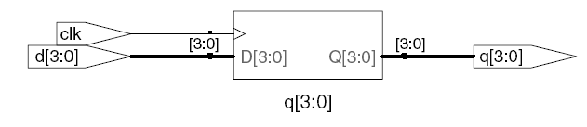
D Flip-Flop
module flop(input logic clk,
input logic [3:0] d,
output logic [3:0] q);
// in old Verilog use
always_ff @(posedge clk) // always @(posedge clk)
q <= d; // pronounced “q gets d”
endmodule

Slide 37
Resettable D Flip-Flop
module flopr(input logic clk,
input logic reset,
input logic [3:0] d,
output logic [3:0] q);
// synchronous reset
always_ff @(posedge clk)
if (reset) q <= 4'b0;
else q <= d;
endmodule

Slide 38
Resettable D Flip-Flop
module flopr(input logic clk,
input logic reset,
input logic [3:0] d,
output logic [3:0] q);
// asynchronous reset
always_ff @(posedge clk, posedge reset)
if (reset) q <= 4'b0;
else q <= d;
endmodule

Slide 39
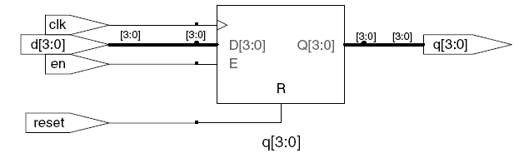
D Flip-Flop with Enable
module flopren(input logic clk,
input logic reset,
input logic en,
input logic [3:0] d,
output logic [3:0] q);
// enable and asynchronous reset
always_ff @(posedge clk, posedge reset)
if (reset) q <= 4'b0;
else if (en) q <= d;
endmodule

